Slide 1

Digital coding of images
AZERBAIJAN STATE OIL AND INDUSTRY UNIVERSITY
Student: Günel Hümbətova
Teacher: Sevinc Karimova
Group:604.20E
Faculty:ITIF

Slide 2

What is a digital image?
A digital image is a representation of a real image as a set of numbers that can be stored and handled by a digital computer. In order to translate the image into numbers, it is divided into small areas called pixels (picture elements). For each pixel, the imaging device records a number, or a small set of numbers, that describe some property of this pixel, such as its brightness (the intensity of the light) or its color. The numbers are arranged in an array of rows and columns that correspond to the vertical and horizontal positions of the pixels in the image.

Slide 3
What is a digital image?
Digital images have several basic characteristics. One is the type of the image. For example, a black and white image records only the intensity of the light falling on the pixels. A color image can have three colors, normally RGB (Red, Green, Blue) or four colors, CMYK (Cyan, Magenta, Yellow, blacK).

Slide 4

What is a digital image?
Depending on whether the image resolution is fixed, it may be of vector or raster type. By itself, the term "digital image" usually refers to raster images or bitmapped images (as opposed to vector images).

Slide 5
What is a Raster Image
Raster images, also known as bitmaps, are comprised of individual pixels of color. Each color pixel contributes to the overall image.
Raster images might be compared to pointillist paintings, which are composed with a series of individually-colored dots of paint. Each paint dot in a pointillist painting might represent a single pixel in a raster image. When viewed as an individual dot, it’s just a color; but when viewed as a whole, the colored dots make up a vivid and detailed painting. The pixels in a raster image work in the same manner, which provides for rich details and pixel-by-pixel editing.

Slide 6
What is a Raster Image
Raster images are capable of rendering complex, multi-colored visuals, including soft color gradients. Digital cameras create raster images, and all the photographs you see in print and online are raster images.
Raster images are ideal for photo editing and creating digital paintings in programs such as Photoshop and GIMP , and they can be compressed for storage and web optimized images.

Slide 7
What is a Raster Image
There are different types of raster files: JPG, GIF, and PNG are examples, and each file type has its own nuances.
How you can use a given raster image depends on its size and quality. Quality is often dictated by how many pixels are contained in an inch, expressed as pixels-per-inch or ppi; as well as the overall dimensions of the image, also expressed as pixels (for example, 5,000 pixels wide by 2,500 pixels high).

Slide 8
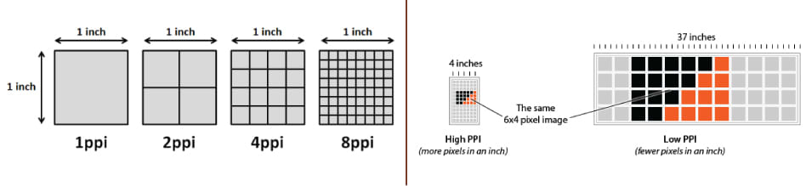
The greater the ppi and dimensional measurements, the higher the quality. Most printing projects require images to be at least 300ppi, for example. Let’s say you’re printing a brochure, and you need a background image to span the entire unfolded interior: 8.5”x11”. Your background image should be at least 2,550 pixels wide (8.5 inches) by 3,300 pixels tall (11 inches) with a resolution of 300ppi.

Slide 9
Vector Images
Unlike raster graphics, which are comprised of colored pixels arranged to display an image, vector graphics are made up of paths, each with a mathematical formula (vector) that tells the path how it is shaped and what color it is bordered with or filled by.
Since mathematical formulas dictate how the image is rendered, vector images retain their appearance regardless of size. They can be scaled infinitely. Vector images can be created and edited in programs such as Illustrator, CorelDraw, and InkScape

Slide 10
How are raster images and vector graphics different?
Since raster images are comprised of colored pixels arranged to form an image, they cannot be scaled without sacrificing quality. If you enlarge a raster, it will pixelate, or become blurry. The lower its resolution (pixels-per-inch), the smaller the image must be to maintain quality.
1. Pixels versus math

Slide 11
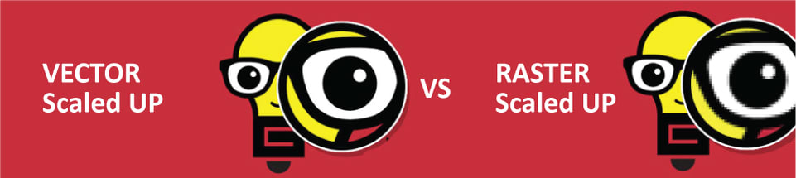
In contrast, the mathematical equations that form the foundations for vectors recalculate when they’re resized; thus, you can infinitely scale a vector graphic and maintain crisp, sharp edges. The difference is easy to see when you zoom on in a raster versus a vector; you can see individual pixels in the raster file, but the vector is still smooth. With vectors, resolution is not a concern.
In contrast, the mathematical equations that form the foundations for vectors recalculate when they’re resized; thus, you can infinitely scale a vector graphic and maintain crisp, sharp edges. The difference is easy to see when you zoom on in a raster versus a vector; you can see individual pixels in the raster file, but the vector is still smooth. With vectors, resolution is not a concern.

Slide 12
2.File type and size
The most common raster file types include JPG, GIF, PNG, TIF, BMP, and PSD. The most common vector file types are AI, CDR, and SVG. Both rasters and vectors can be rendered in EPS and PDF format, where the software that created the file dictates whether it’s a raster or vector file.

Slide 13
Raster | Vector
Comprised of pixels, arranged to form an image | Comprised of paths, dictated by mathematical formulas
Constrained by resolution and dimensions | Infinitely scalable
Capable of rich, complex color blends | Difficult to blend colors without rasterizing
Large file sizes (but can be compressed) | Small file sizes
File types include .jpg, .gif, .png, .tif, .bmp, .psd; plus .eps and .pdf when created by raster programs | File types include .ai, .cdr, .svg; plus .eps and .pdf when created by vector programs
Raster software includes Photoshop and GIMP | Vector software includes Illustrator, CorelDraw, and InkScape
Perfect for “painting” | Perfect for “drawing”
Capable of detailed editing | Less detailed, but offers precise paths

Slide 14
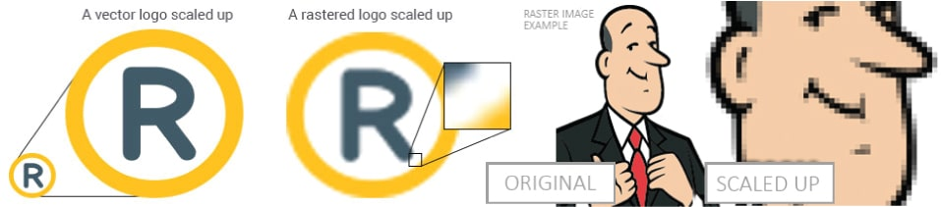

Slide 15
3.When should you use raster or vector?
Raster images are best for photos, while vectors are best for logos, illustrations, engravings, etchings, product artwork, signage, and embroidery. Some liken raster images to paintings and vectors to drawing; if your project requires complex color blends, such as in painting, raster is the preferred format; if your project requires scalable shapes and solid colors, such as in drawing, vector is the best choice.
Many projects combine raster and vector images together: a brochure, for example, might include a corporate logo (vector) and a photo of happy customers (raster) – often coupled in layout software such as InDesign or QuarkXpress (though Illustrator and Photoshop can also be used to pair raster and vector images).

Slide 16
RGB Color Model (RGB)
The RGB color model is a color model used largely in display technologies that use light. In this model, the colors red (R), green (G) and blue (B) are added together at different intensities to produce millions of different colors on modern video display screens.
The RGB color model is based on a the science of the human eye perceives light and translates it into brain waves. This model is extremely common for TV and video displays, video game console displays, digital cameras and other types of light-based display devices. The RGB model is as an "additive" model: as colors are added, in the form of light, the result becomes lighter. For instance, the full combination of red, green and blue produces white.

Slide 17
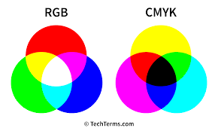
An alternative model to the RGB model is the CMYK model, which is used for color printing. This model uses the colors cyan (C), magenta (M), yellow (Y) and black (K), which is called the “key.” Whereas RGB is additive, CMYK is subtractive. This is because the CMYK system uses colored inks to mask colors on a white background and "subtracts" brightness from that white background.

Slide 18
Resources:
https://www.psprint.com/resources/difference-between-raster-vector/
https://www.encyclopedia.com/computing/news-wires-white-papers-and-books/digital-images
https://www.techopedia.com/definition/5555/rgb-color-model-rgb

Slide 19

Thank you for attention

